Slide 1


Portfolio Project # 02
RFM Analysis
on
SMART SUPPLY CHAIN
Presented By:
Sameen Fatima
Data Analytics – Cohort 4

Slide 2
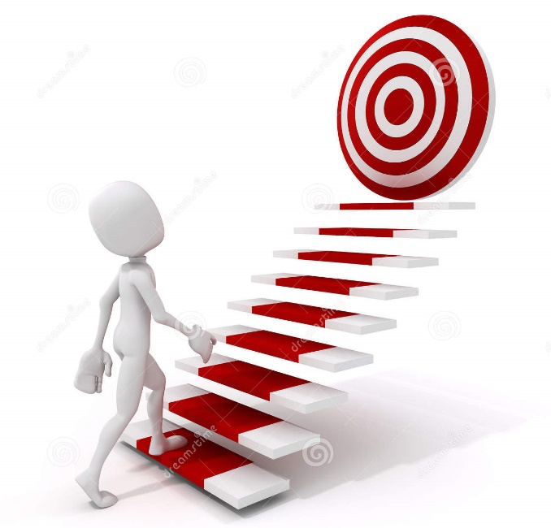
Roadmap
About Dataset
What is RFM?
Objective & Metrics of RFM
Some important KPIs
Insights
Recommendations

Slide 3
About Dataset
A Data Set of Supply Chains by the company Data Co Global was used for the analysis. The data contains information about customers, orders, products and shipment details.
Stakeholders:
Industrialists
Suppliers
Operational Managers
Consumers
Government (imposing international and national regulations)

Slide 4
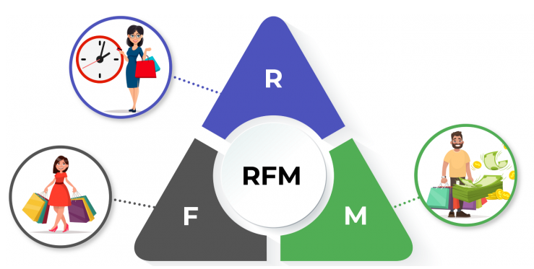
What is RFM?
RFM analysis is one of the most common techniques for customer segmentation used for making targeted promotions by marketing department
This segmentation helps us to identify our most valuable customer.
But what does RFM stands for?
Recency: How recent was the last purchase.
Frequency: Total number of transactions a customer made.
Monetary: Value of total purchases done by a customers.

Slide 5
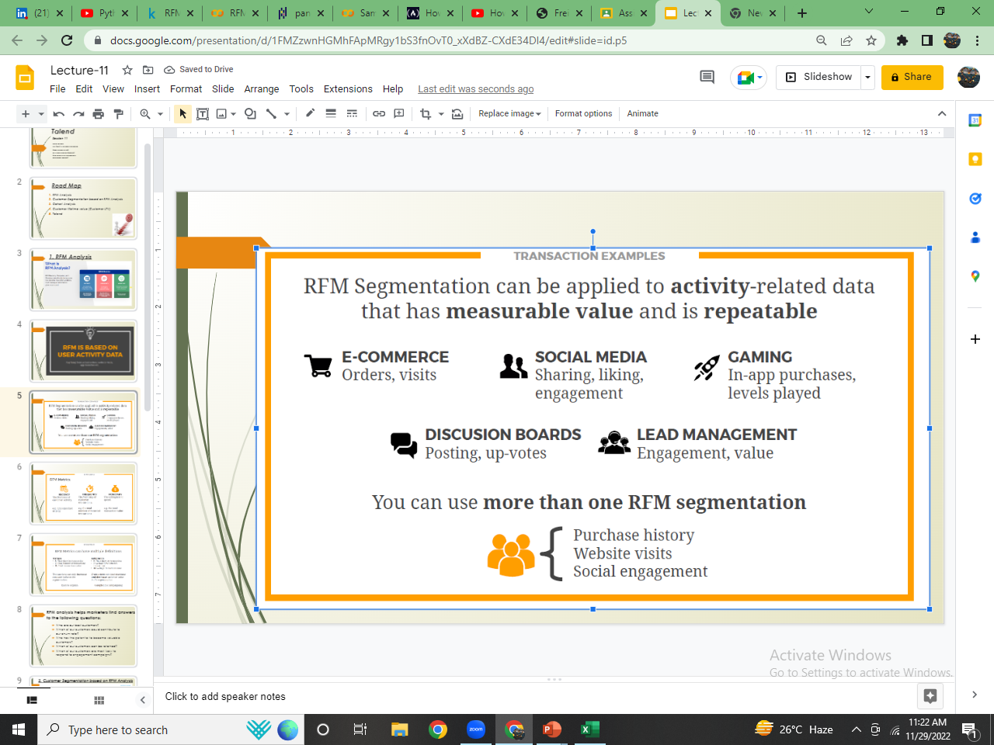
Where it can be applied?
Notes:
Benefits
To improve customer lifetime value
RFM segmentation for new product launches
RFM to minimize marketing costs and improve ROI

Slide 6
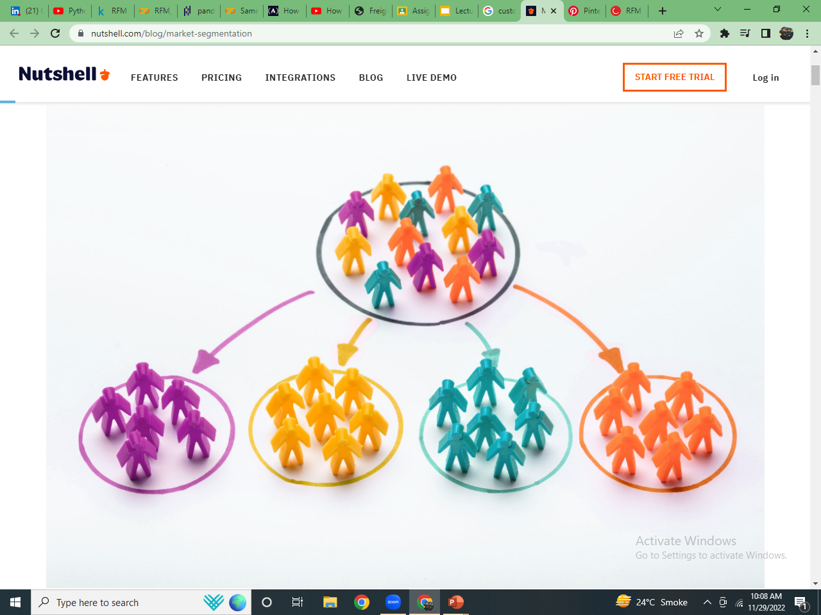
Objective
The objective to perform RFM analysis is to know:
Who are our best customers?
Which of our customers could contribute to our churn rate?
Who has the potential to become valuable customers?
Which of our customers can be retained?
Which of our customers are most likely to respond to engagement campaigns?

Slide 7
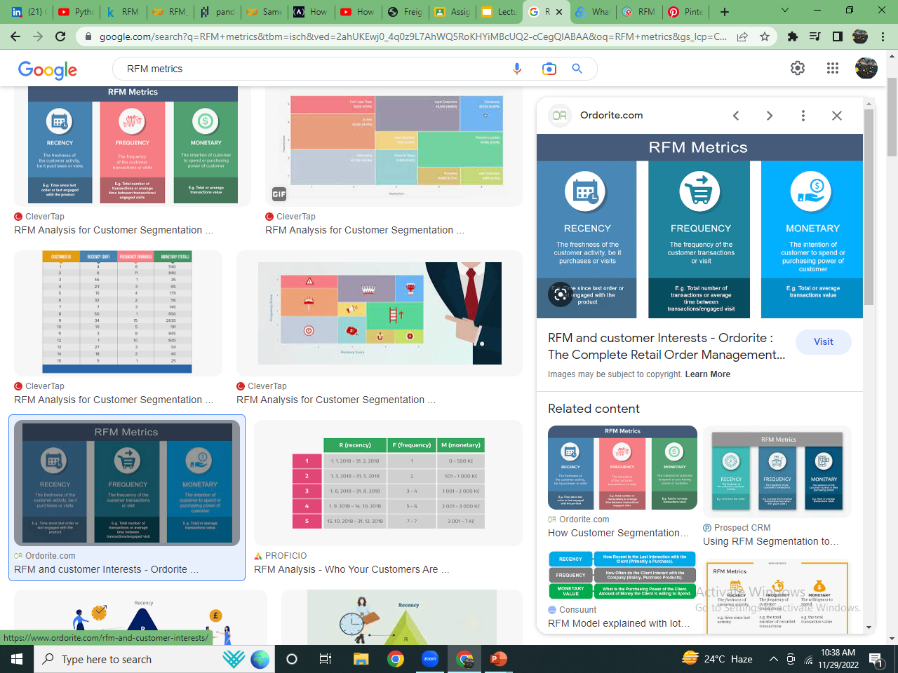
RFM Metrics
Recency Value
Ideally the difference between the customer last purchase date and the most recent date.
The more recent the purchase, more responsive the customer is to promotions
Frequency Value
Count of orders Placed by each customer.
The more frequently the customer buys, the more engaged and satisfied the customers are.
Monetary Value
Total value of all purchases made by the customer.
The monetary values helps us to distinguish between big spenders and low spenders.

Slide 8
RFM Scores
The recency, frequency and monetary values were sorted and then divided in 3 quantile range using formula and then assigned scores of recency, frequency, monetary accordingly where
3 being the most important.
1 being the least important.
R Score | F Score | M Score | Segments
3 | 3 | 3 | champions
3 | 3 | 1-2 | Loyal customers
3 | 1 | 1-2-3 | New customers
2 | 1-2 | 3 | Big spenders
1-2 | 1-2 | 3 | at risk
2 | 1 | 1-2-3 | Unsatisfied Customers
1 | 1-2 | 1-2 | churned

Slide 9
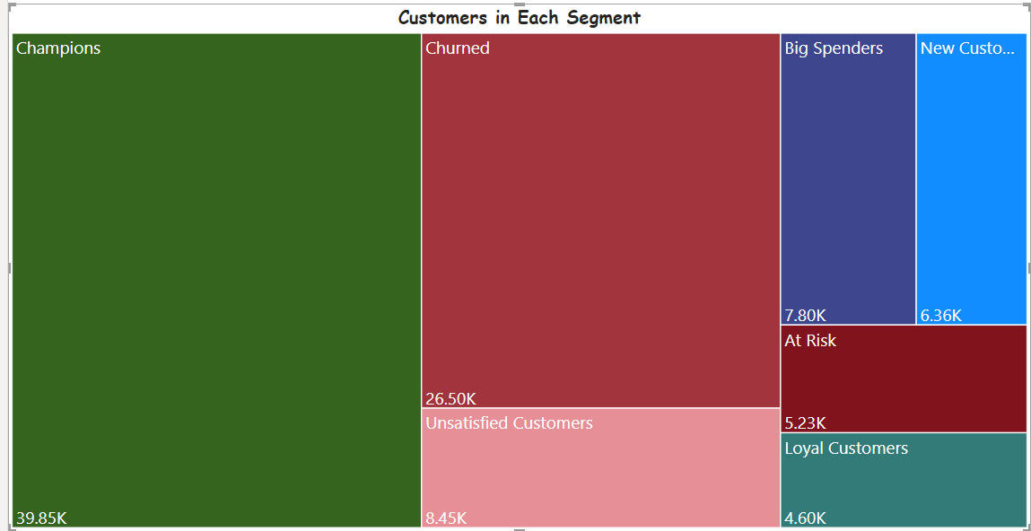
Customer Segments
The Tree map Shows most of our customers are ‘champions’ which is a good sign but also, the second top category shows ‘churned customers’ which is quite alarming.
Notes:
Now, Let’s have a look at products and their categories our customers are spending the most in.

Slide 10
Few Important KPIs
Top Selling categories
Top Selling Products
Sales generated by each segment
Customer’s Churn Rate
Shipping Mode of orders by Delivery status
Country wise Late Delivery Risk

Slide 11
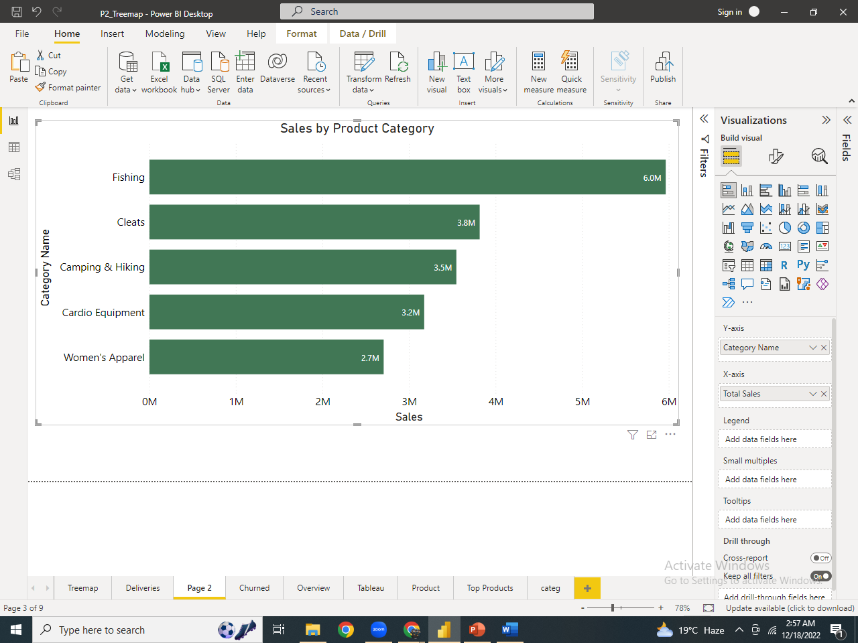
Top Selling categories
Product items belonged to Fishing, Cleats, Camping & Hiking etc. are being bought by most of our customers.
Notes:
Let’s first discover the products and their categories which are most popular among our ‘Champions’ and ‘Big spenders’.

Slide 12
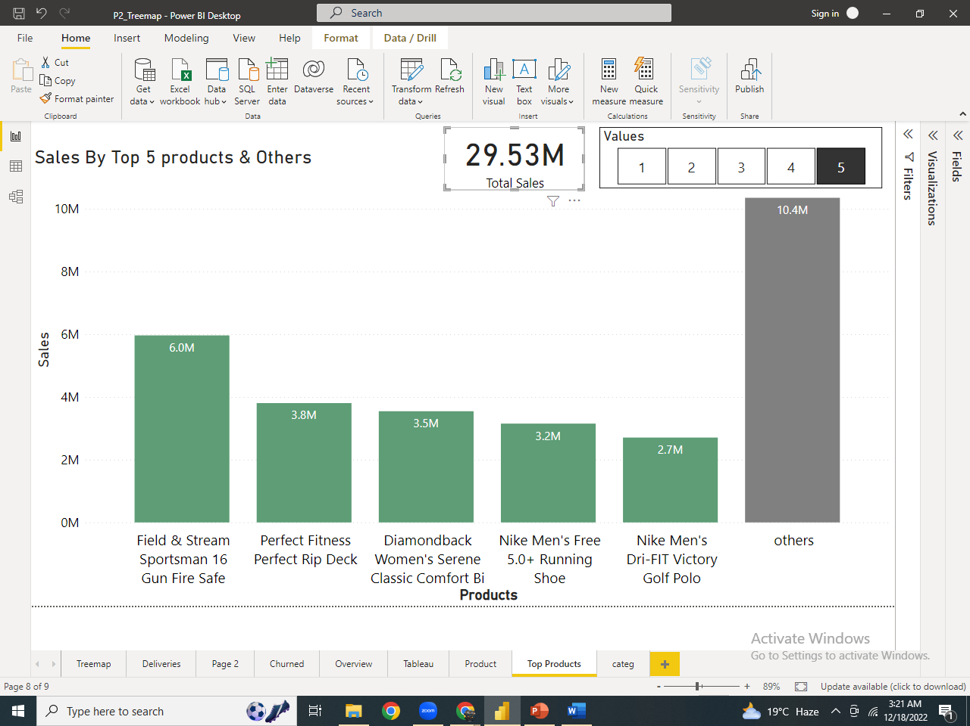
Top Selling Products
Out of 29.35M of sales, these 5 products are producing 19.2M and rest of the products are generating only 10M of sales. So these 5 are the most important Products of our company.
Because 65% of the revenue was generated by these 5 products so we must never compromise on the Quality of these product in order to gain customer’s satisfaction & loyalty.

Slide 13
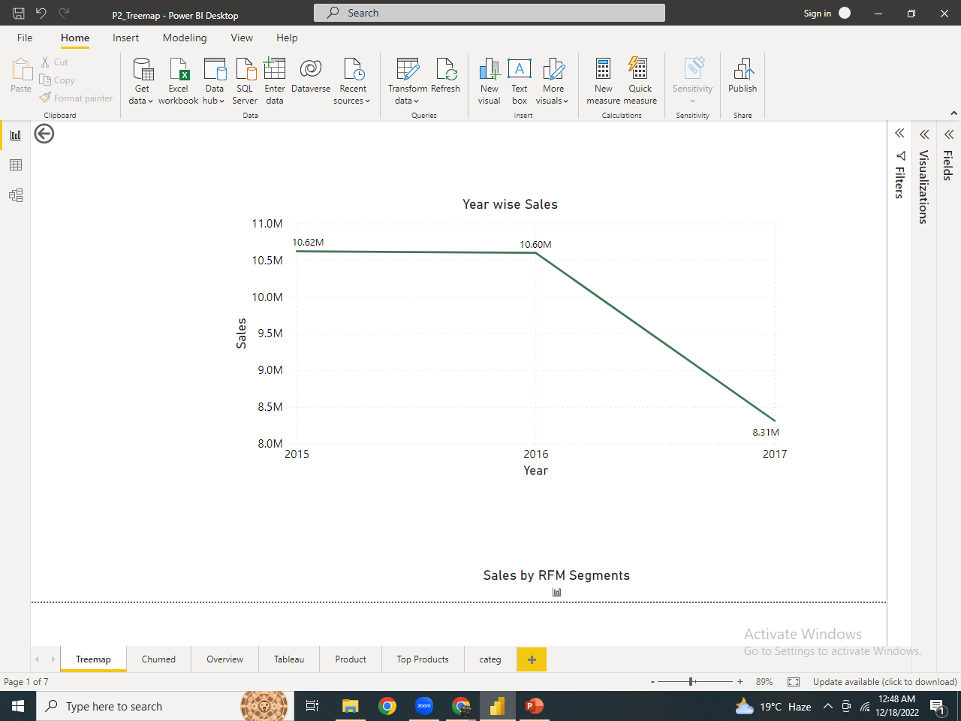
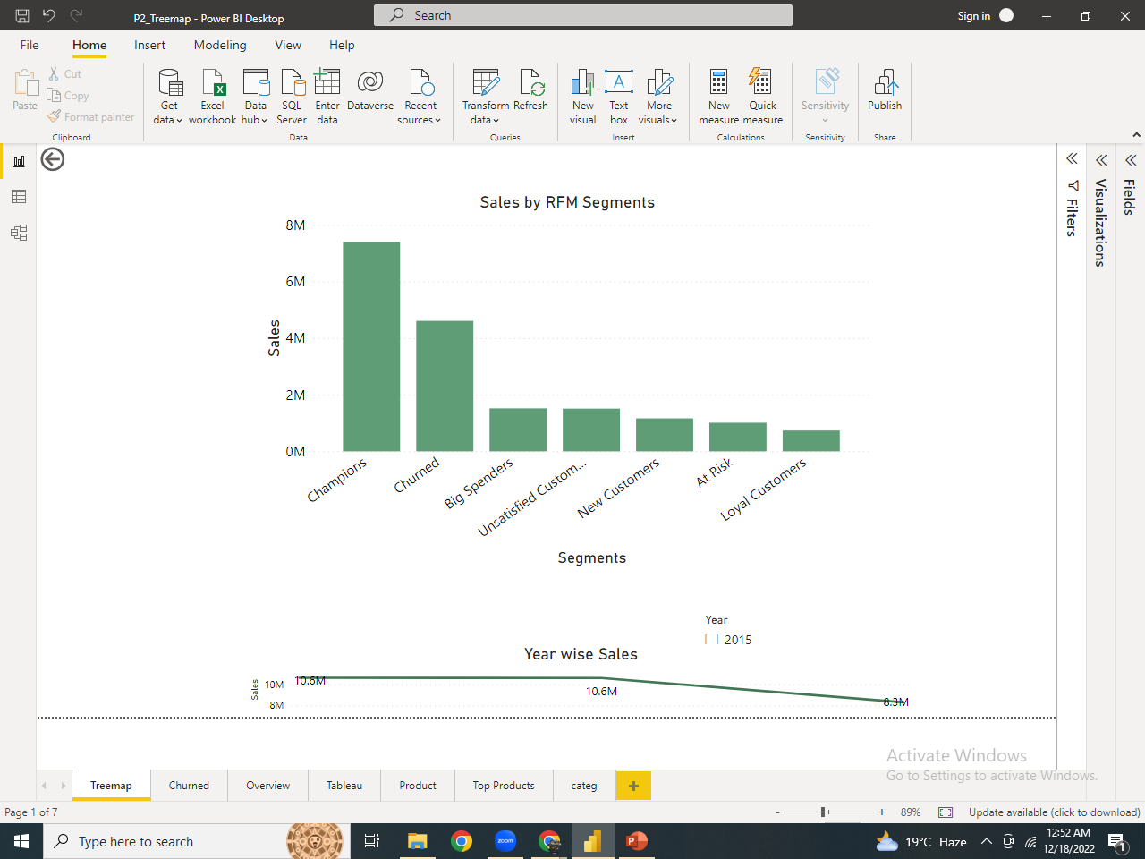
Sales generated by each segment
The line graph shows a critical decline of sales in 2017.
On further analysis we figured out that the customers who have churned were among the top contributors in revenue making.
Notes:
Now, Let’s figure out why customers are churning?

Slide 14
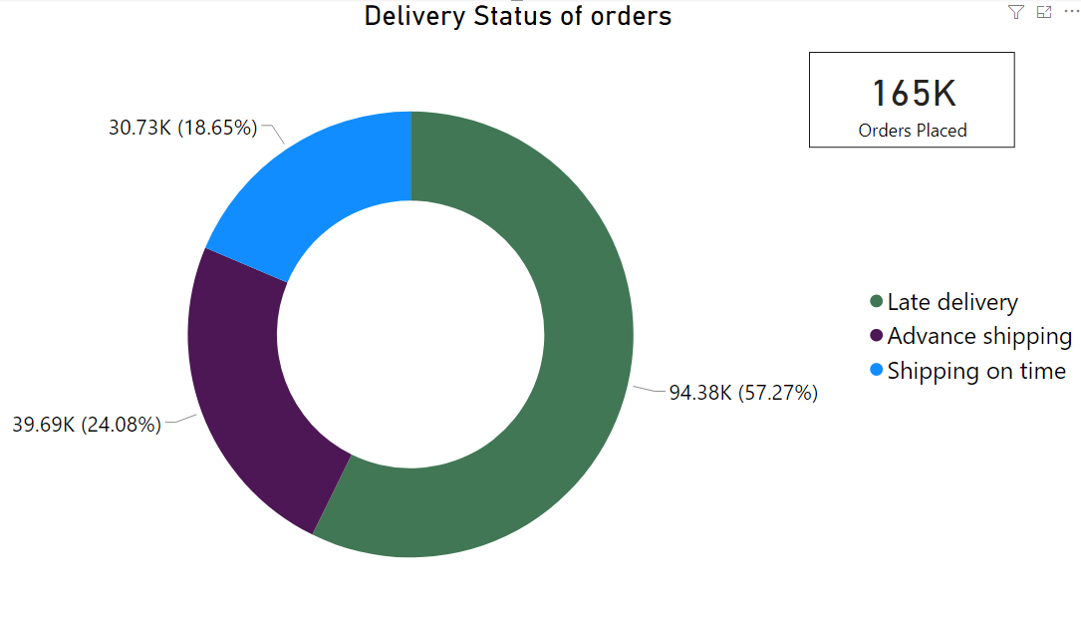
Why are Customers Churning?
Out of 165K orders, 94.38K were delivered late.
Which could be the main reason of customer’s churn.

Slide 15
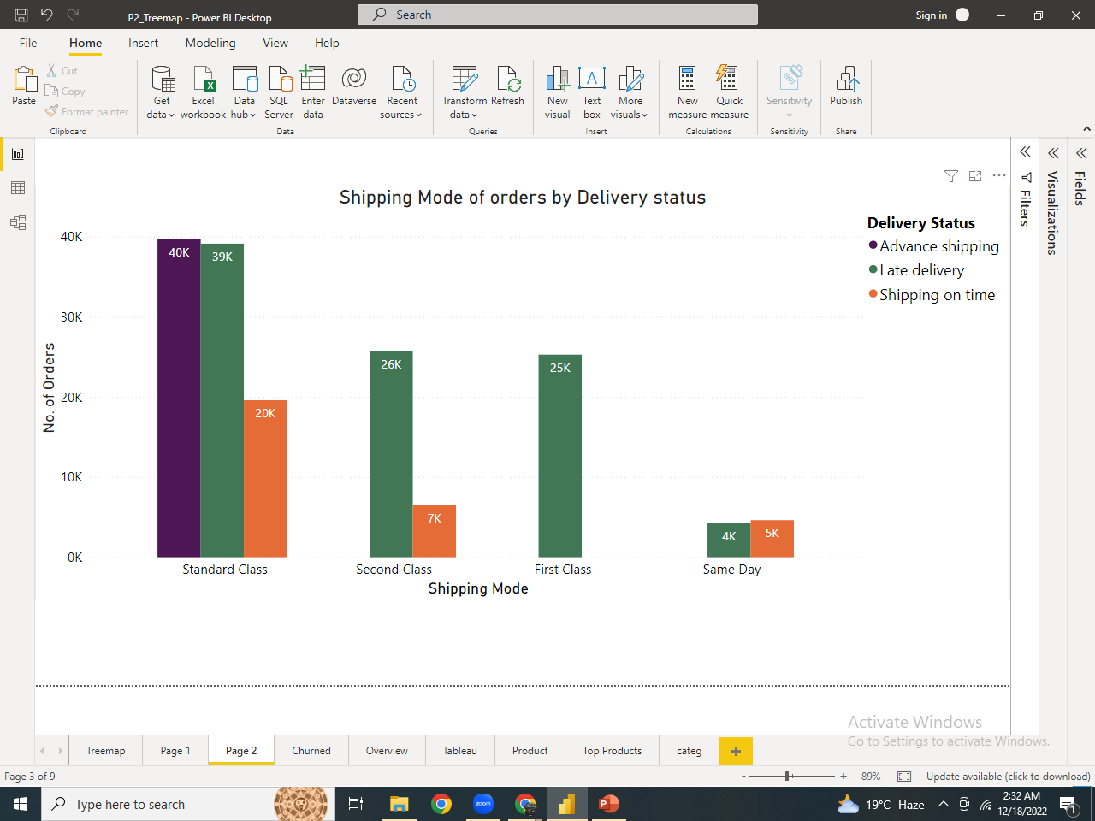
Shipping Mode of orders by Delivery status
The visual clearly depicts the first class deliveries were all delayed & orders were delivered in advance only in Standard class
Notes:
On further drilling down we got to know that Maybe due to traffic , first class deliveries are late.

Slide 16
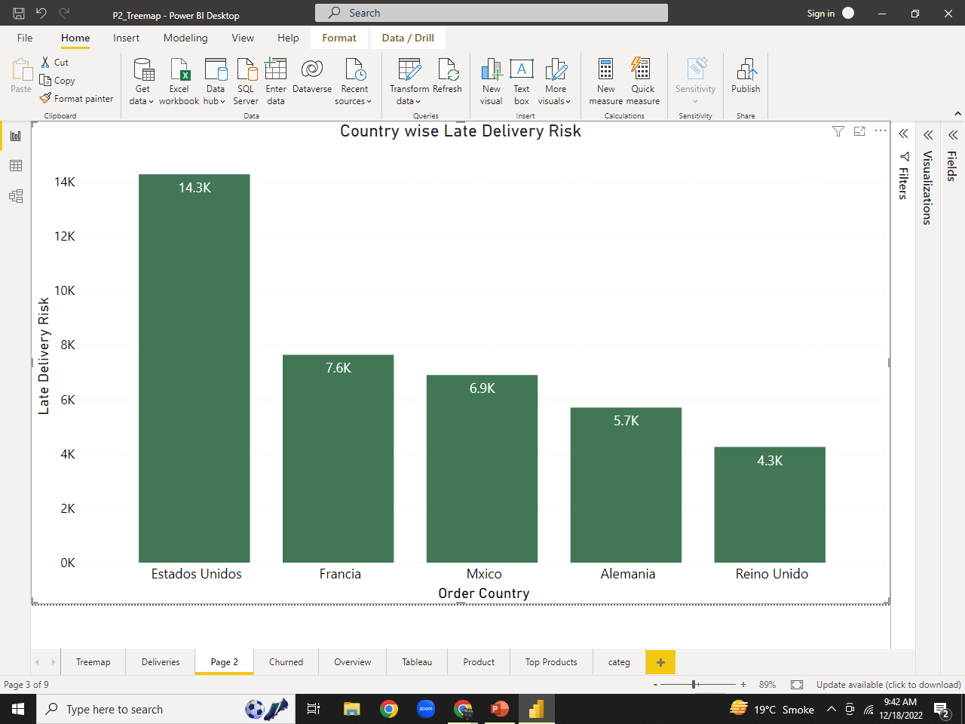
Country wise Late Delivery Risk
Estados Unidos, A country in North America has the high risk of late Deliveries which is quite alarming and needed to be fixed soon.
39% of buyers are less likely to shop in our store again if their purchase is not delivered within the promised delivery days and hence contributing in churn rate.

Slide 17
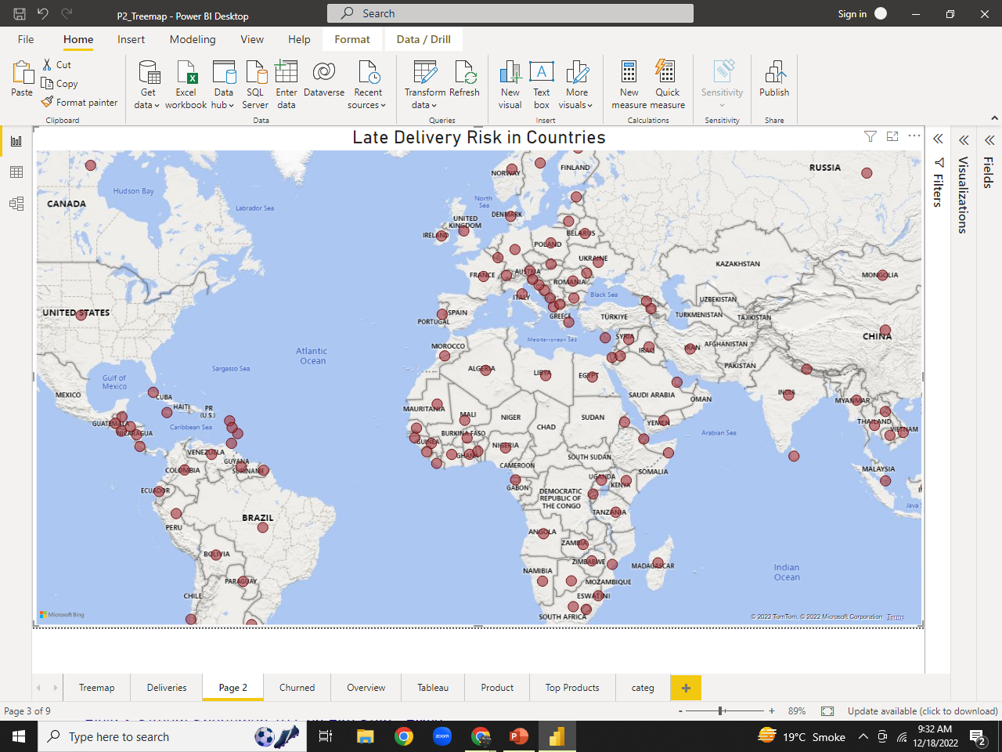
Overall Late Delivery Risk in Countries
Notes:
Tracking of routes to get informed about traffic like google map does.

Slide 18
Recommendations:
We can reduce customer churn and assure them fast & smooth deliveries by:
Improve communication with drivers
Monitoring driver’s performance.
Automating route planning and driver dispatch.
Providing customers real-time driver tracking.

Slide 19
Strategies to be adapted
Segments | Strategies
champions | Customers in this segment visits the store frequently and buys quality products even if they are expensive. The brand value and exclusiveness of the products matter for them. Send them promotional messages of exclusive products or when new stocks arrive at the store.
Big spenders | They look for quality and exclusivity regardless of money . We can dive into the specifics of the purchases individually for each customer, and try to offer them similar deals on their next purchase to retain them.
New customers | They are new customers who have recently visited our stores. Provide them the best service. Try to retain them by offering discounts on their next visit.
Loyal customers | They visit our store frequently and look for the quantity and quality both. Offer them discounts and promotional offers to retain them.
At risk | They purchase from us occasionally, less frequently but are big spenders. They are looking for quality and exclusivity and when they find it out our store they purchase from us. we can dive into the specifics of the purchases individually for each customer and try to offer them similar deals on their next purchase to retain them
Unsatisfied Customers | Their low frequency indicates that they were not happy with the experience at the stores. We can also call them reluctant buyers. Our aim should be to convert them to Loyal customers or big spenders by communicating with them and providing good after sales services.
Churned | They were once loyal customers but now have churned. Try to win them back by offering good deals and special discounts. Also assure them fast, smooth deliveries as late deliveries was the main reason of customer churn.

Slide 20

Any Question

